Slide 1
PROJECT :
LINK : https://www.kaggle.com/kandij/mall-customers
DATA : Mall Customers

Slide 2
Goal:
You are owing a supermarket mall and through membership cards , you have some basic data about your customers like Customer ID, age, gender, annual income and spending score. Spending Score is something you assign to the customer based on your defined parameters like customer behavior and purchasing data.

Slide 3
Challenges faced in the project :
There was no target variable present in the dataset
Find the optimum number of clusters required.

Slide 4
MY LEARNINGS:
Deal with unlabeled data.
Concept of clustering
K means Clustering
Elbow method
Silhouette score

Slide 5
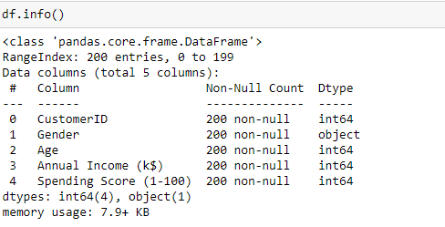
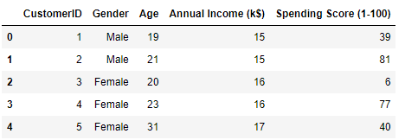
VARIABLES PRESENT IN DATASET :

Slide 6
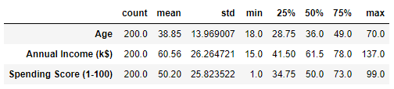
DESCRIPTIVE STATISTICS OF DATASET :

Slide 7
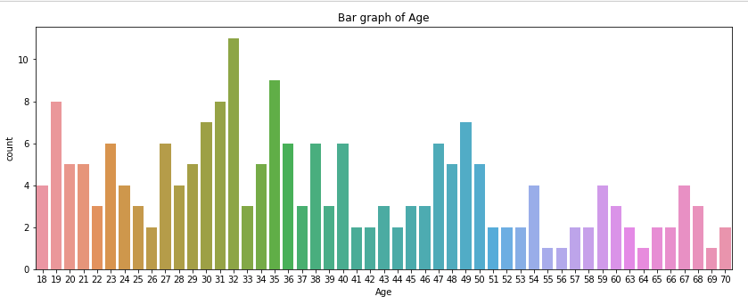
Major findings in eda :
AGE
There are more people of age between 30-35 who are going to mall regularly or more and senior citizens visits the mall least. From the count plot we confer that people of age group 27-32 visits mall more frequently and people of age group 55,56,64,69 visits least of all.

Slide 8
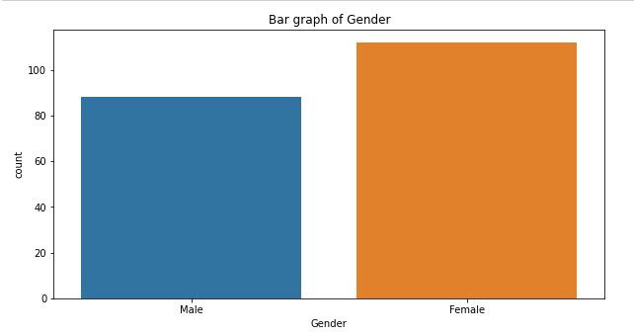
GENDER
We see that male have spending score of around 25-70 and females have 35-75 which concludes that females shops more.

Slide 9
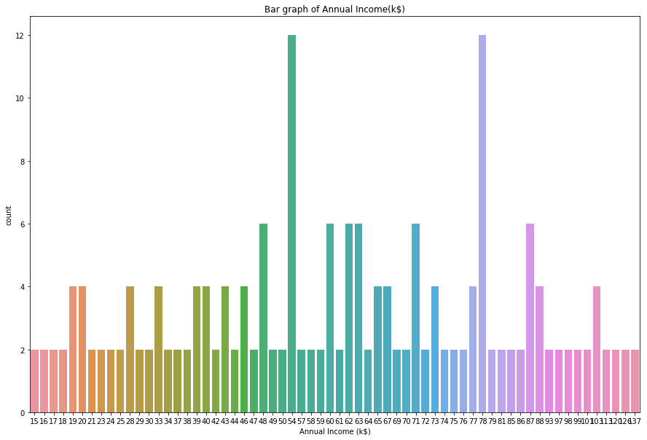
ANNUAL INCOME (k$)
That most of the people have earnings from 50-75 dollars and from count plot people of age group 54 and 78 have max. annual income and also people having age group of 64 earns the least and of 41 highest and of range 27-41 have average or more earnings.

Slide 10
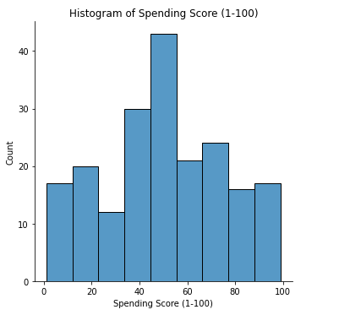
SPENDING SCORE (1-100)
most of the people have their spending score in the range of 35-60.

Slide 11
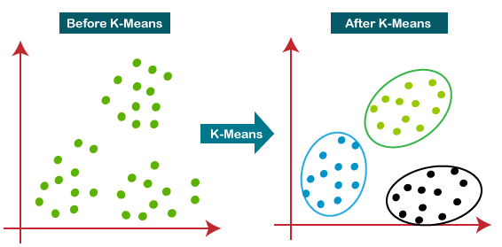
ALGORITHM USED :
K - Means Clustering
K-Means clustering is the most popular unsupervised machine learning algorithm, which is used when you have unlabeled data. The goal of this algorithm is to find groups in the data, with the number of groups represented by the variable K.

Slide 12
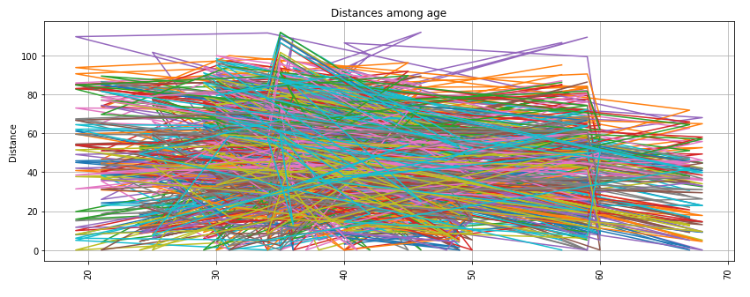
K – means in dataset :
DISTANCE MATRIX
Age was set as index.

Slide 13
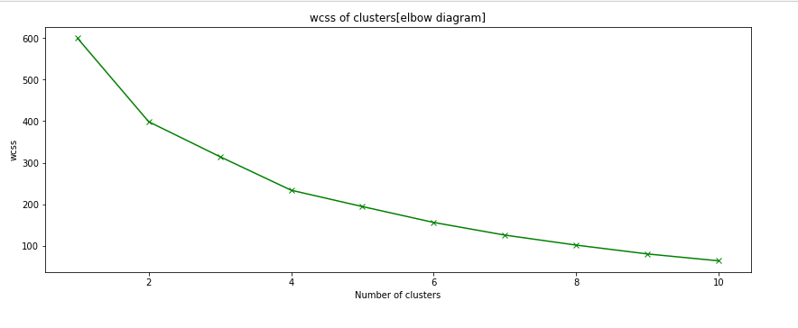
OPTIMUM NUMBER OF CLUSTERS
n = 4

Slide 14

SILHOUETTE SCORE
The silhouette score falls within the range [-1, 1]. The silhouette score of 1 means that the clusters are very dense and nicely separated. The score of 0 means that clusters are overlapping. The score of less than 0 means that data belonging to clusters may be wrong/incorrect.

Slide 15
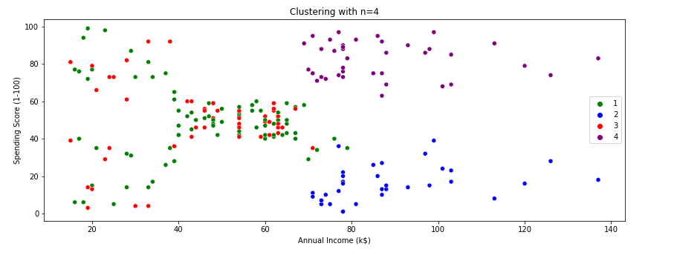
PLOTTING OF CLUSTERS

Slide 16
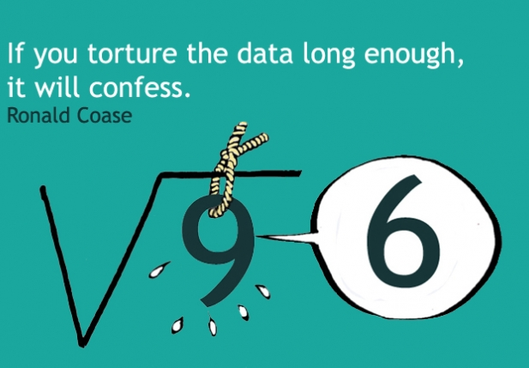
Thank you for viewing my work!!!

